Slide 1
MAC Security
Tirthankar Ghosh

Slide 2
Introduction
Standardized in 2006,
Media Access Control security (MACSec – IEEE802.1AE) specifies how encryption can be used to secure links.
Provides source authentication, data integrity check, and encryption on each hop.
Transparent to layer 3 and higher layer protocols.

Slide 3
Overview
MACSec (IEEE802.1ae), along with KeySec (IEEE802.1af), define Link Security as the layer 2 link security standard.
KeySec defines the key management protocol for MACSec.
Load balancing and traffic management are easier to perform in a secure environment.

Slide 4
How MACSec Works
KeySec creates the CA using MACSec key agreement entity (KaY) of each member device.
MACSec provides the secure entity (SecY) for each member device.
KeySec defines a secure channel (SC) between the SecY of each CA member device.
Each SC is unidirectional; for full bidirectional, secure communication between two devices, two SCs must be defined.
Each SC has secure association keys (SAKs) negotiated by KeySec, which is used for authentication and encryption.

Slide 5
How MACSec Works (cont’d)
Secure Connectivity Association (CA) is created for connectivity between stations attached to a LAN.
Each CA is supported by a unidirectional Secure Channel (SC). Each SC supports secure transmission through the use of symmetric key cryptography.
Each SC is supported by a sequence of Security Associations (SA).
Each SA uses a fresh Secure Association Key (SAK).

Slide 6
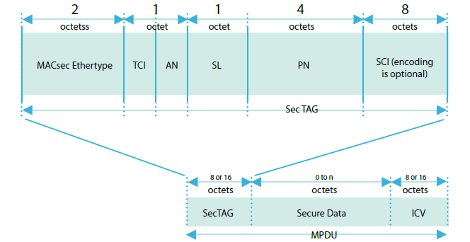
MACSec Frame Format

Slide 7
MACSec Frame Format (cont’d)
The Security TAG (SecTAG) is identified by the MACsec EtherType, and conveys the following:
a) TAG Control Information (TCI)
b) Association Number (AN)
c) Short Length (SL)
d) Packet Number (PN)
e) Optionally encoded Secure Channel Identifier (SCI)

Slide 8
MACSec EtherType
The MACsec EtherType comprises octet 1 and octet 2 of the SecTAG. It is included to allow:
a) Coexistence of MACsec capable systems in the same environment as other systems
b) Incremental deployment of MACsec capable systems
c) Peer SecYs to communicate using the same media as other communicating entities
d) Concurrent operation of Key Agreement protocols that are independent of the MACsec protocol and the Current Cipher Suite
e) Operation of other protocols and entities that make use of the service provided by the SecY’s
Uncontrolled Port to communicate independently of the Key Agreement state

Slide 9
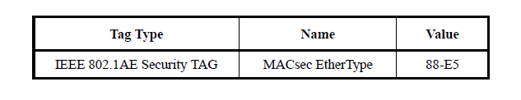
MACSec EtherType Allocation

Slide 10
TAG Control Information
8-bit field to facilitate:
a) Version numbering of the MACsec protocol without changing the MACsec EtherType
b) Optional use of the MAC Source Address parameter to convey the SCI
c) Optional inclusion of an explicitly encoded SCI
d) Use of the EPON Single Copy Broadcast capability, without requiring an explicit SCI to distinguish the SCB Secure Channel
e) Extraction of the User Data from MPDUs by systems that do not possess the SAK when confidentiality is not being provided
f) Determination of whether confidentiality or integrity alone are in use

Slide 11
Short Length (SL)
SL is an integer encoded in bits 1 through 6 of octet 4 of the SecTAG and is set to the number of octets in the Secure Data field, i.e., the number of octets between the last octet of the SecTAG and the first octet of the ICV, if that number is less than 48.
Otherwise, SL is set to zero.
If the number is zero then the frame is deemed not to have been short.

Slide 12
Packet Number
The PN is encoded in octets 5 through 8 of the SecTAG to:
a) Provide a unique IV PDU for all MPDUs transmitted using the same SA
b) Support replay protection

Slide 13
Secure Channel Identifier (SCI)
If the SC bit in the TCI is set, the SCI is encoded in octets 9 through 16 of the SecTAG, and provides:
a) Identification of the SA where the CA comprises three or more peers
b) Network management identification of the SecY that has transmitted the frame

